Slide 1
Adversarial Search
Chapter 5

Slide 2
Types of games
 | Deterministic | Chance
Perfect information | chess, checkers, Go, Othello | backgammon, monopoly
Imperfect information |  | bridge, poker, scrabble, nuclear war

Slide 3

Game tree (2-player, deterministic, turns)

Slide 4
Minimax
Perfect play for deterministic games
Idea: choose move with highest minimax value
= best achievable payoff against best play
Minimax-value (n):
  Utility (n) if n is a terminal state
  Max (Minimax-value(s)) if n is a MAX node
  Min (Minimax-value(s)) if n is a MIN node
  where s is the set of successors of n

Slide 5

Minimax
Example 2-ply game:

Slide 6

Minimax algorithm

Slide 7
Properties of minimax
Complete? Yes (if tree is finite)
Optimal? Yes (against an optimal opponent)
Time complexity? O(b^{m})
Space complexity? O(bm) (depth-first exploration)
For chess, b ≈ 35, m ≈100 for "reasonable" games
→ exact solution completely infeasible

Slide 8
α-β pruning
Cuts minimax’s time needs by up to half O(b^{m/2}) by pruning bad branches
Alpha – value of best choice (highest value) for MAX
Beta – value of best choice (lowest value) for MIN
Algorithm keeps updating alpha and beta values as search goes on and prunes any node or branch with a value worse than the current alpha or beta values

Slide 9

α-β pruning example

Slide 10

α-β pruning example

Slide 11

α-β pruning example

Slide 12

α-β pruning example

Slide 13

α-β pruning example

Slide 14
Properties of α-β
Pruning does not affect final result
Good move ordering improves effectiveness of pruning
With good ordering, time complexity = O(b^{m/2})
  → doubles depth of search
A simple example of the value of reasoning about which computations are relevant (a form of meta-reasoning)

Slide 15

Why is it called α-β?
α is the best value found so far at any choice point along the path for max
If v is worse than α, max will avoid it
  → prune that branch
Define β similarly for min

Slide 16

The α-β algorithm

Slide 17

The α-β algorithm

Slide 18
Resource limitations
Some games involve having to make real-time decisions
  Need to avoid searching until the terminal states if time limits are imposed
A possible approach:
Use a cutoff test instead of a terminal test
  Cut off search at an appropriate depth limit
Use a heuristic evaluation function instead of a utility function
  Estimated desirability of position

Slide 19
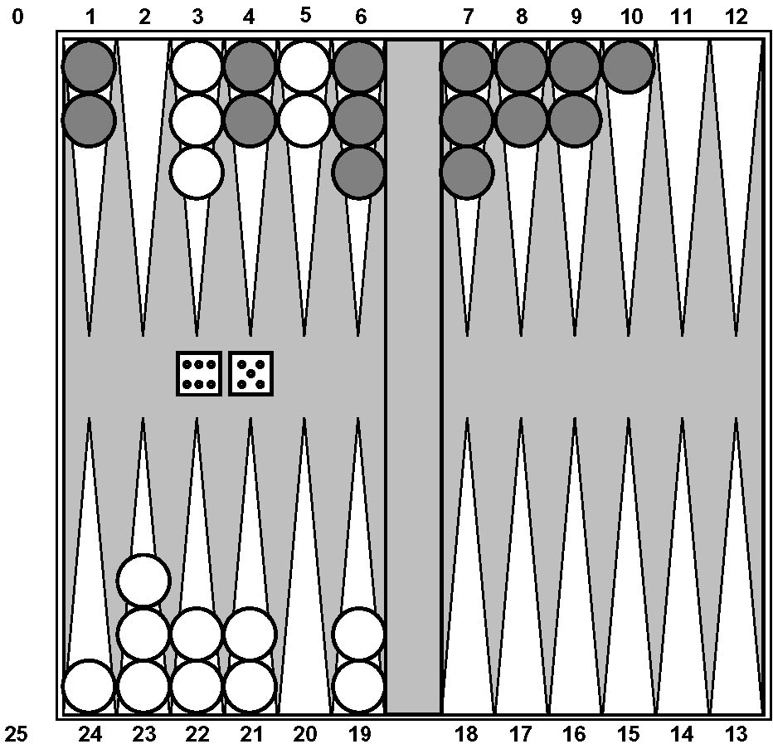
Nondeterministic games: backgammon

Slide 20
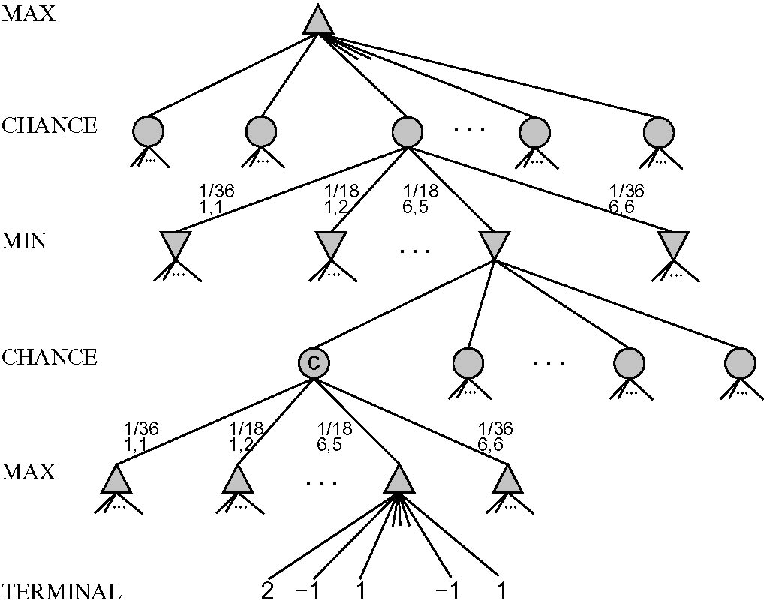
Nondeterministic games
Chance introduced by dice, card-shuffling
Backgammon example:

Slide 21
Algorithm for nondeterministic games
Expectiminimax gives perfect play
Just like Minimax, except we must also handle chance nodes
Expectiminimax (n):
Utility (n) if n is a terminal state
Max Expectiminimax (s) if n is a MAX node
Min Expectiminimax (s) if n is a MIN node
Σ P(s) ⋅ Expectiminimax (s) if n is a chance node
where s belongs to the set of successors of n

Slide 22
Games of imperfect information
Example: card games where opponent’s initial cards are unknown
Idea: compute the minimax value of each possible action in each deal, then choose action with the highest expected value over all deals
Example: GIB, current best bridge program:
  Generates 100 deals consistent with bidding information
  Selects action that wins the most tricks on average

Slide 23
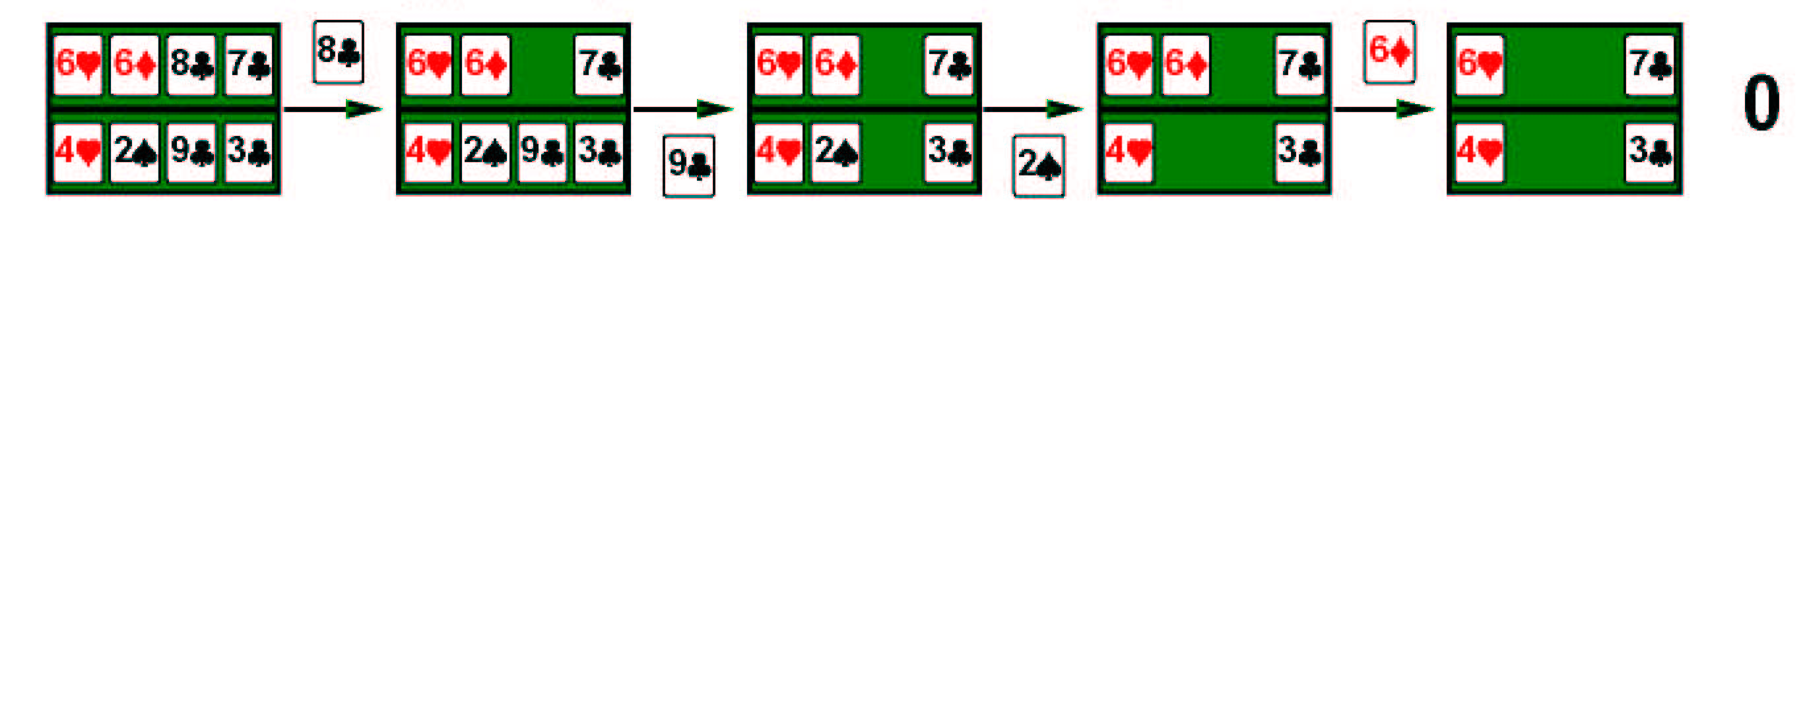
Example
Four cards bridge/hearts hand, MAX to play first

Slide 24
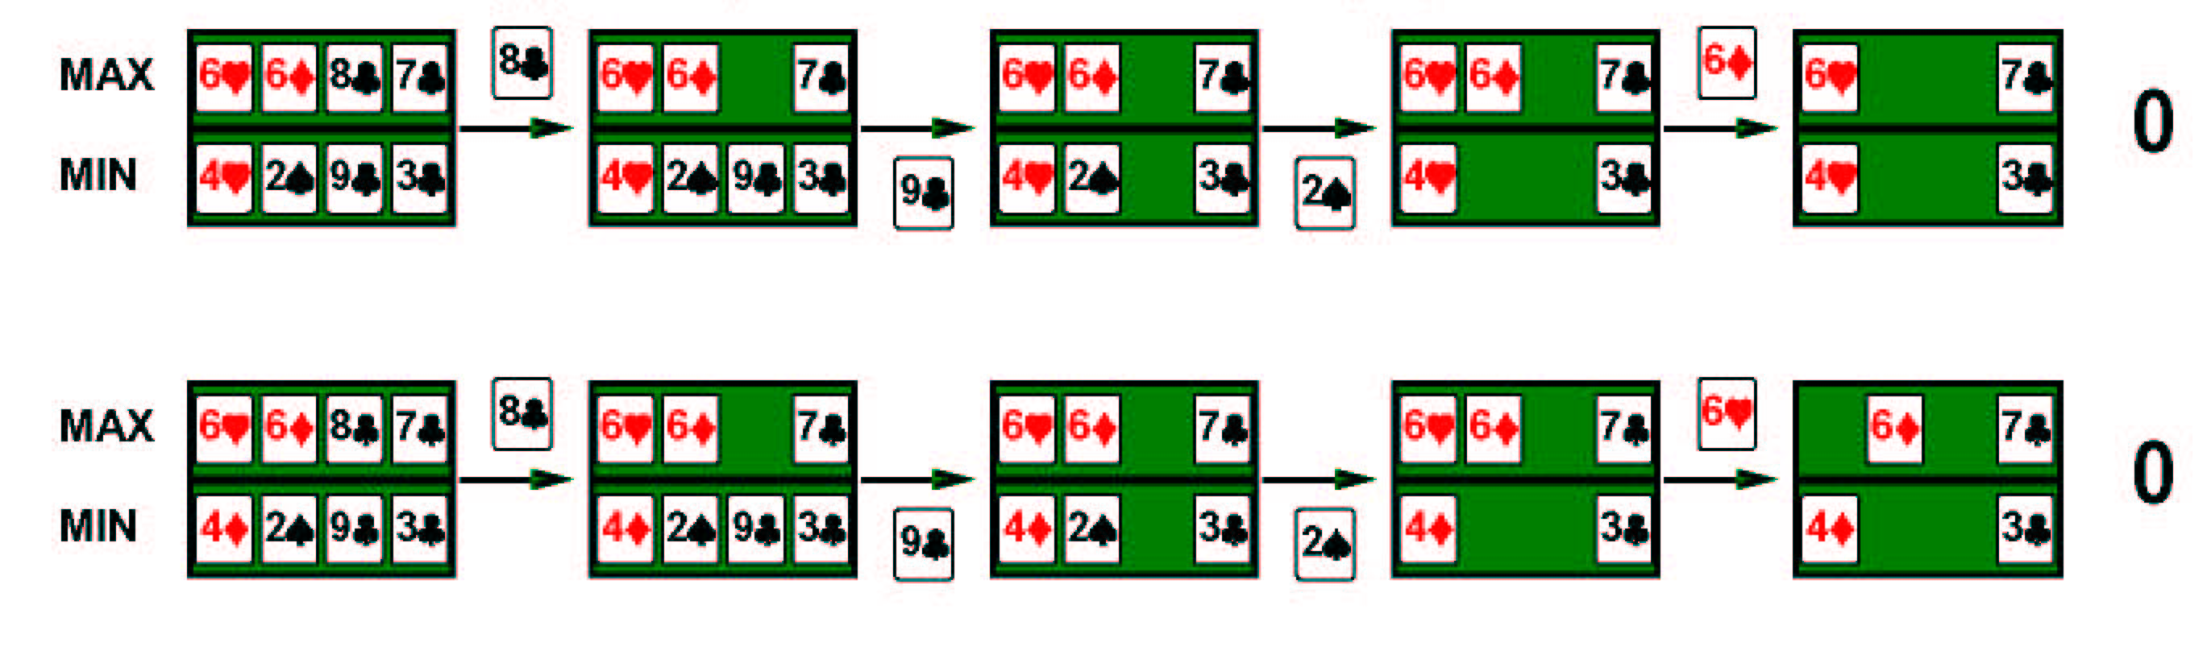
Example
Four cards bridge/hearts hand, MAX to play first

Slide 25
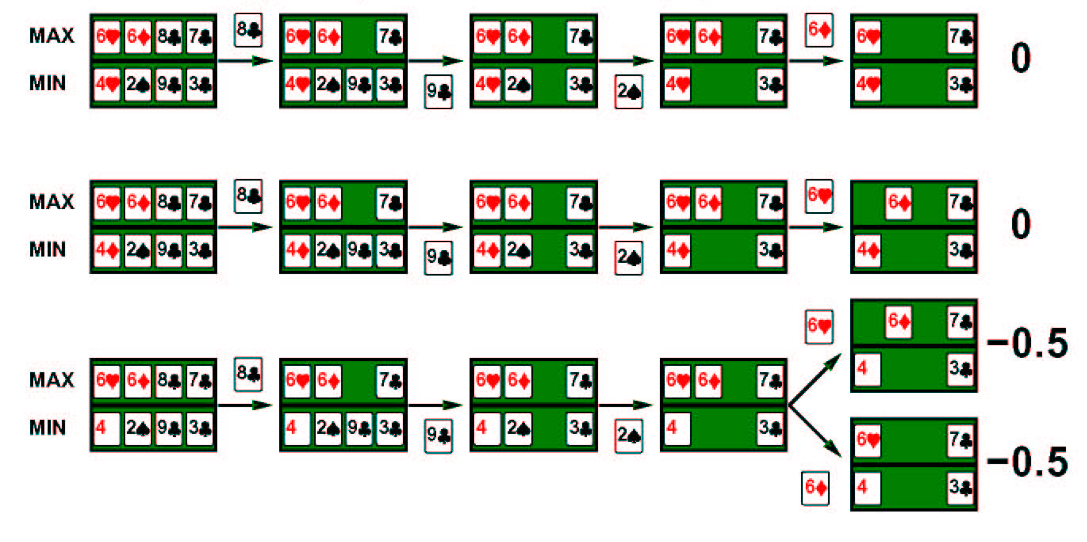
Example
Four cards bridge/hearts hand, MAX to play first

Slide 26
State-of-the-art Games
Checkers:
  Chinook ended 40-year-reign of human world champion in 1990
  Uses alpha-beta search with a pre-computed endgame database defining perfect play for all positions involving 8 or fewer pieces on the board, a total of 39 trillion positions
Othello:
  Human champions refuse to compete against computers, who are too good
  Logistello defeated world champion in 1997
  5-15 legal moves, smaller search space than chess

Slide 27
State-of-the-art Games
Chess:
  Deep Blue defeated human world champion Garry Kasparov in a six-game match in 1997
  Core search technique: iterative deepening alpha-beta search
  Deep Blue searches 200 million positions per second, uses very powerful heuristic methods (e.g. null move heuristic and futility pruning) that reduce branching factor from 35 to 3 and extend some lines of search up to 40 ply
  Also uses powerful hardware search: 30 processors (software search), 480 custom VLSI chess processors for move generation and ordering
  Hydra: runs on 64-processor cluster with 1 Gb/processor + null-move heuristic + forward pruning → 18 ply search
  Rybka: won 2008 & 2009 World Chess Championships, 8-core 3.2 GHz Intel Xeon processor + powerful evaluation function → strongest computer player

Slide 28
State-of-the-art Games
Go:
  Human champions refuse to compete against computers, who are too bad
  19 x 19 board, b > 300, so most programs use pattern recognition-based knowledge bases to suggest plausible moves
  Geomate and Go4++ rated as weak amateurs
  MoGo defeated professional player in August 2008
  Current programs play at master level on 9 x 9 board, but at advanced amateur level on full board
Backgammon:
  TD-Gammon ranked among top 3 players
  Combines reinforcement learning with neural nets

Slide 29
Summary
Games illustrate several important points about AI:
  Perfection is often unattainable → must approximate
  Useful to think about what to think about (meta-reasoning)
  Uncertainty constrains assignment of values to states
“Game playing is to AI as Grand Prix motor racing is to the car industry.”

